Slide 1
FLOOD MONITORING AND EARLY WARNING

Slide 2
AGENDA
The objective of this project is to design, develop and build a flood warning system to alert and warn the people and it help in save lives and reduce property damage.

Slide 3
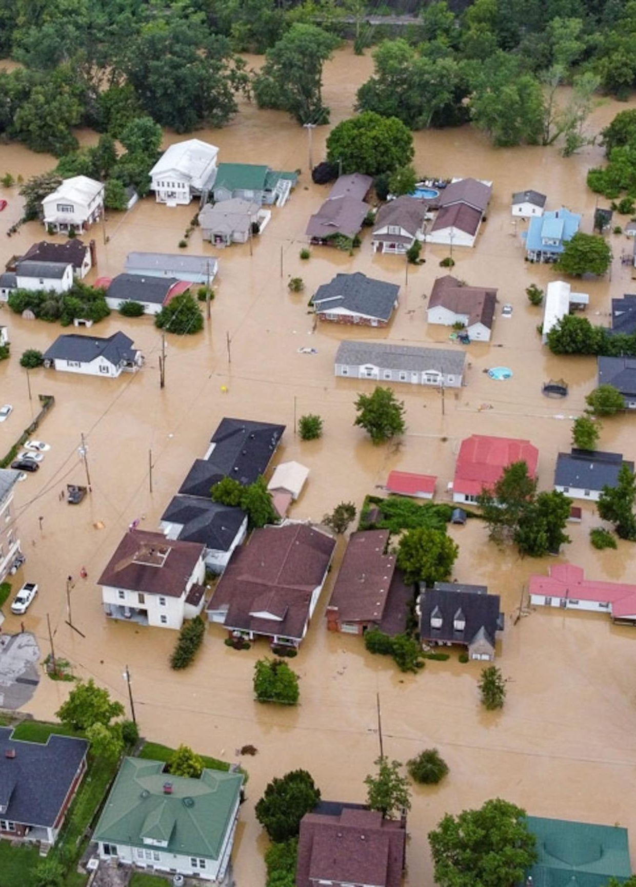
PROBLEM STATEMENT
Effective flood management is crucial for safeguarding lives, property, and the environment in flood-prone areas. However, there are numerous challenges associated with flood management that require attention
Predictive Accuracy
Environmental Impact
Policy and Governance
Solving these challenges requires interdisciplinary efforts involving meteorologists, hydrologists, engineers, policymakers, and communities to create a comprehensive flood management strategy that minimizes risks and ensures the safety and well-being of affected populations.

Slide 4
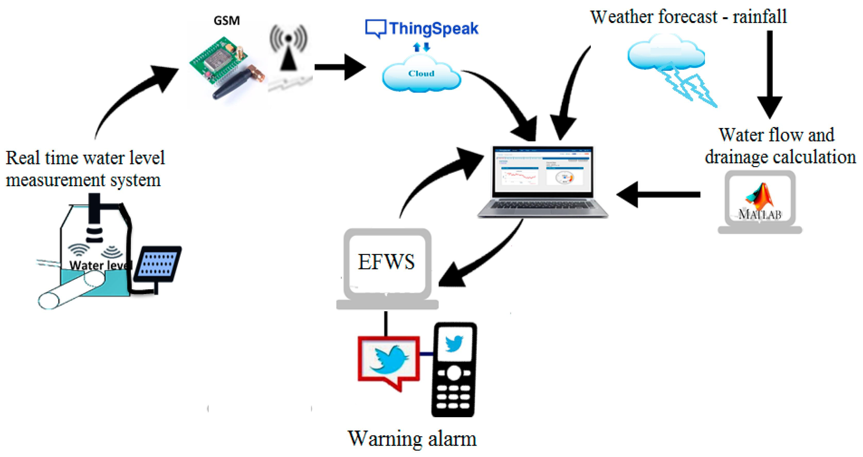
Flood monitoring
A flood monitoring system is used to monitor a rise in water levels.The system comprises sensors that are deployed in cities or any areas of interest.The sensors can be connected to either the main electricity or can be solar-powered.These sensors are deployed on bridges,wells,lakes or beaches to measure water levels in real-time and continuously send data remotely to the centralized data system management via different networks such as GSM, mobile cell networks or Wi-Fi.

Slide 5
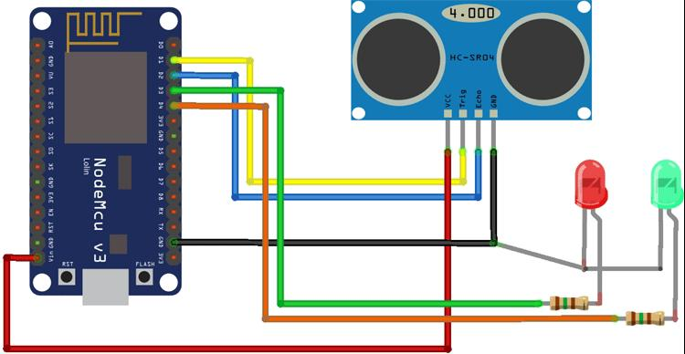
Early warning system
Flood early warning system (FLEWS) is a system by which flood induced hazards can be minimised and prevented.The system should provide timely and accurate warnings to residents and authorities before a flood event occurs. This involves establishing threshold levels for different parameters and triggering warnings when threshold are exceeded.

Slide 6
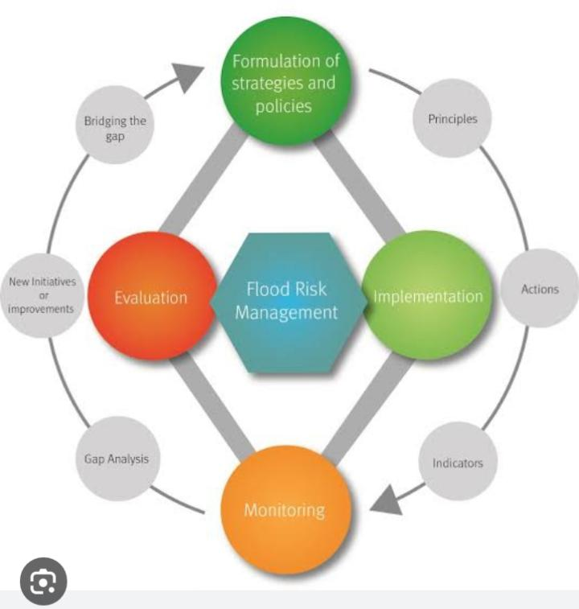
METHODOLOGY
The methodology of flood monitoring involves :
Flood plan
Incentives and rehabilitation
Flood forecast
Vulnerability assessment
Flood risk mapping
Reducing flood level

Slide 7
Problem solution
Hardware and Technology : Invest in advanced technology such as weather radar, remote sensing, and early warning systems. Ensure proper maintenance of hardware components.
Data Integration:Invest in integrated data platforms and Geographic Information Systems (GIS) for better data management and sharing among agencies.

Slide 8
Conclusion
In conclusion, flood management is a critical endeavor that encompasses a wide range of strategies and actions aimed at reducing the risks and impacts of flooding on communities, infrastructure, and the environment. Effectively managing floods requires a holistic approach that combines predictive accuracy, infrastructure resilience, community preparedness, and environmental protection. It also involves the use of advanced technology, data integration, and strong governance. As the world faces increasing challenges due to climate change and urbanization, flood management becomes even more essential. Adaptation to changing climate patterns, sustainable land use practices, and international cooperation are key aspects of modern flood management strategies.

Slide 9
Thank you

